Slide 1
The Quest
A Hero’s Journey
http://www.ifoundries.com/blog/wp-content/uploads/2009/03/journey-image-1.jpg

Slide 2
The Quest
A Journey in which the hero goes in search of something valuable
What he finds is often not exactly what he was looking for
It is still of great value

Slide 3
Elements of the Quest
The Call to Adventure the point in The hero’s life when he is first given notice that everything is going to change, whether he knows it or not.
They are “called “ to the task and often refuse at first

Slide 4
The Threshold The hero crosses into the field of adventure, leaving the known limits of his world and venturing into an unknown and dangerous realm where the rules are suspended
http://farm3.static.flickr.com/2673/4107603174_e0a150b33c_m.jpg

Slide 5
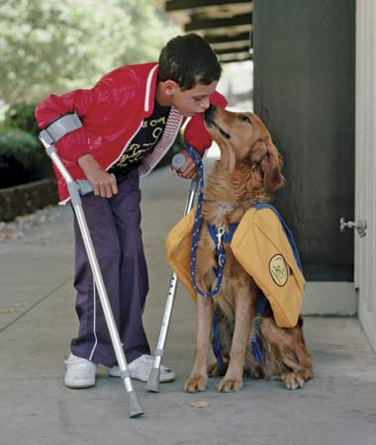
Elements of the Quest
Helpers and Mentor Once the hero has committed to the quest, his or her guide and magical helper appears, or becomes known.
http://advocacy.britannica.com/blog/advocacy/wp-content/uploads/service-dog.jpg

Slide 6
Challenges and Temptations- The Road of Trials
a series of tests, tasks, or ordeals that the Hero must undergo to begin the transformation. Often the hero fails one or more of these tests, which often occur in threes.

Slide 7
Challenges and Temptations- The Road of Trials
One of those
temptations may
lead the hero to
abandon or
stray from his
quest.
http://jasonhirsch.files.wordpress.com/2009/06/saupload_temptation_21.jpg

Slide 8
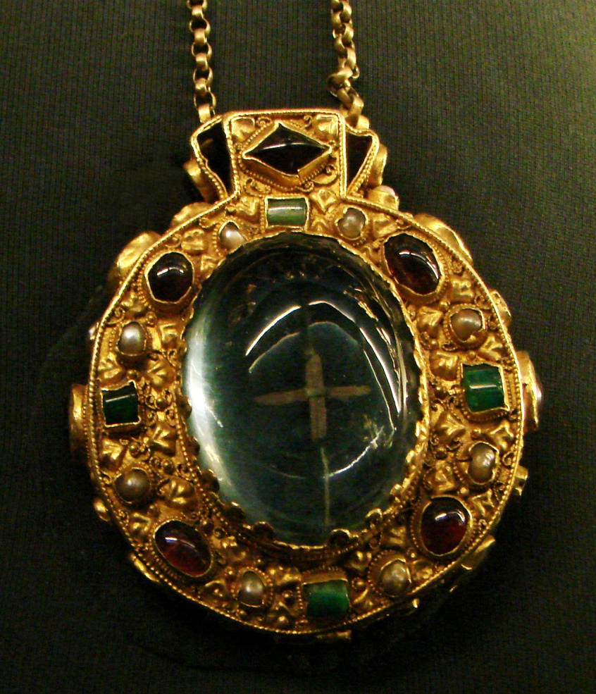
The Talisman
The hero will encounter and sometimes use objects that have magical or supernatural powers.
good or bad.
http://upload.wikimedia.org/wikipedia/commons/f/f3/Talisman_de_Charlemagne_Tau.jpg

Slide 9
The Abyss
The hero encounters and sometimes use objects that have magical or supernatural powers.
These objects can be used for good or bad.
http://endtimepilgrim.org/abyss.jpg
http://upload.wikimedia.org/wikipedia/commons/f/f3/Talisman_de_Charlemagne_Tau.jpg

Slide 10
The Revelation
The hero realizes something important about himself and his quest.
http://childrensbook.files.wordpress.com/2008/01/light-bulb-716935.jpg

Slide 11
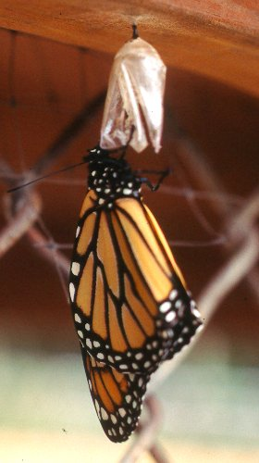
The Transformation
The hero is changed due to the revelation.
http://mynotetakingnerd.files.wordpress.com/2009/09/transformation-butterfly.jpg

Slide 12
The Atonement
The hero will
recognizes and accept his wrongs and try to make amends for them.
http://assets.communityspice.com/bsmthroneofhisglorysummits/assets/Bev%20Pictures/man%20praying%20on%20one%20knee.jpg

Slide 13
The Gift and Return
The hero learns from his experiences and takes his knowledge back home to share with others.
http://www.perannum.co.uk/ist2_2446495_glowing_christmas_gift.jpg

Slide 14
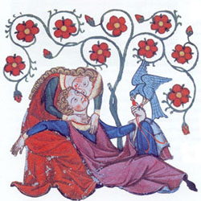
Courtly Love

Slide 15
Ideal Love
Real life will never arranges itself exactly like a romance.
During “courtship” a woman is in control of the relationship where a man’s obedience and submission inspires him to do great deeds

Slide 16
History
In 1168, Eleanor of Aquitaine left the court of her husband Henry II and went to Poitou. She was the ruling duchess, and she wielded the power of a feudal lord. She was a beautiful woman with charm,style, and iron will.
Because of this she was greatly admired. Poets, chroniclers, musicians, philosophers, artists, would flock around her.

Slide 17
The Stages of Courtly Love
Attraction to the lady, usually via eyes/glance
Worship of the lady from afar
Declaration of passionate devotion
Virtuous rejection by the lady
Renewed wooing with oaths of virtue and eternal fealty
Moans of approaching death from unsatisfied desire (and other physical manifestations of lovesickness)
Heroic deeds of valor which win the lady's heart
Consummation of the secret love
Endless adventures and subterfuges avoiding detection

Slide 18
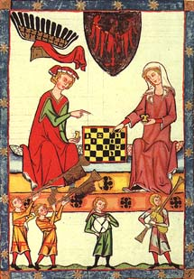
The Twelve Rules of Love from The Art of Courtly Love by Andreas Capellanus
1. Thou shalt avoid avarice like the deadly pestilence and shalt embrace its opposite.
2. Thou shalt keep thyself chaste for the sake of her whom thou lovest.
3. Thou shalt not knowingly strive to break up a correct love affair that someone else is engaged in.

Slide 19
The Twelve Rules of Love from The Art of Courtly Love by Andreas Capellanus
4. Thou shalt not chose for thy love anyone whom a natural sense of shame forbids thee to marry.
5. Be mindful completely to avoid falsehood.

Slide 20
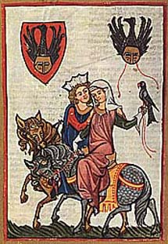
Rules continued
6. Thou shalt not have many who know of thy love affair.
7. Being obedient in all things to the commands of ladies, thou shalt ever strive to ally thyself to the service of Love.
8. In giving and receiving love's solaces let modesty be ever present.
9. Thou shalt speak no evil.

Slide 21
Rules continued
10. Thou shalt not be a revealer of love affairs.
11. Thou shalt be in all things polite and courteous.
12. In practicing the solaces of love thou shalt not exceed the desires of thy lover.

Slide 22
Six "Not so good" Things About Courtly Love
1. Unrealistic
Typically the courtly love relationship was not between husband and wife.
2. Adulterous
Although this aspect bothers modern readers more than past readers.
3. Put women on an inaccessible pedestal

Slide 23
Six "Not so good" Things About Courtly Love
4. In some situations, it enabled the knight from reaching his full potential.
- Ex: Guinevere and Lancelot
5. Distraction
6. Suffering symptoms of love

Slide 24
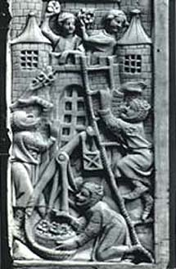
The Literary Convention of Courtly Love
- In France and England, courtly love became a central theme of lyric and epic poetry.
- The literary convention of courtly love appears in works of most of the major authors of the Middle Ages including Geoffrey Chaucer (Canterbury Tales).
- Courtly love conventions are found in the medieval genres of lyric, the allegory and the Romance (such as Sir Gawain and the Green Knight)

Slide 25
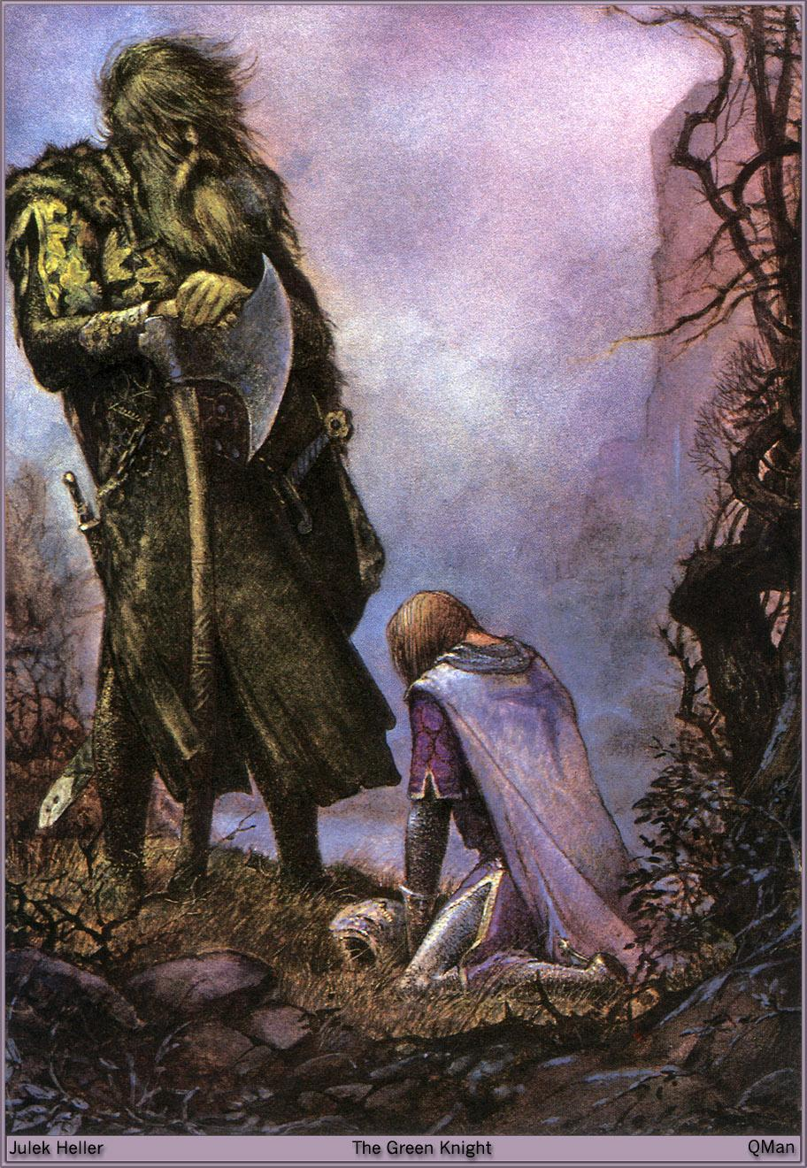
Courtly Love in Sir Gawain and the Green Knight
- The ideals of courtly love were often impossible to adhere to. A perfect knight in the service of the Virgin Mary, would be ,at times, caught in the tension between courtly love’s code of behavior, the expectations of duty and courtesy, and the strict moral demands of Christianity.

Slide 26
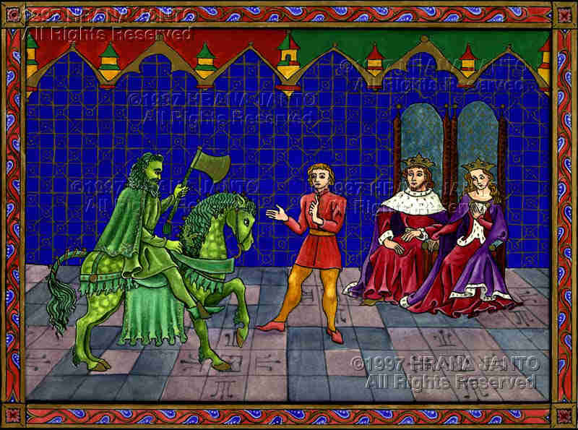
- In Sir Gawain and the Green Knight, Sir Gawain must respect both the laws concerning courtly love and the laws of chivalry.
- The knight’s code requires that Sir Gawain do whatever a lady asks, and because of this Gawain finds himself in a difficult situation .
He can’t win

Slide 27
- When Gawain makes a choice, he is breaking his promise to one while keeping a promise to another.
- This demonstrates the conflict between honor and knightly duties. By breaking his promise, Gawain believes he has lost his honor and failed in his duties.

